Slide 1



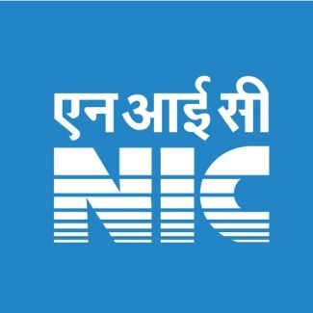
Ministry of Electronics & Information Technology
ReALCRAft
Registration and License issuing system to Indian Fishing Vessels
A Project to Strengthen the Coastal & Fishermen Security,
National Database on Fishing Vessels
A Joint Initiative of DAFD, Govt. of India & National Informatics Centre

Slide 2

CSI SIG eGovernance (CSeGA) Awards 2020 Projects Sustenance Awards Category
Agenda
Project Background and Objectives
Services
Major Milestones & Present Status
Roadmap
Additional Enhancements

Slide 3
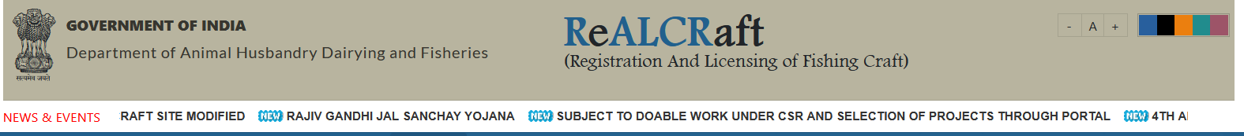
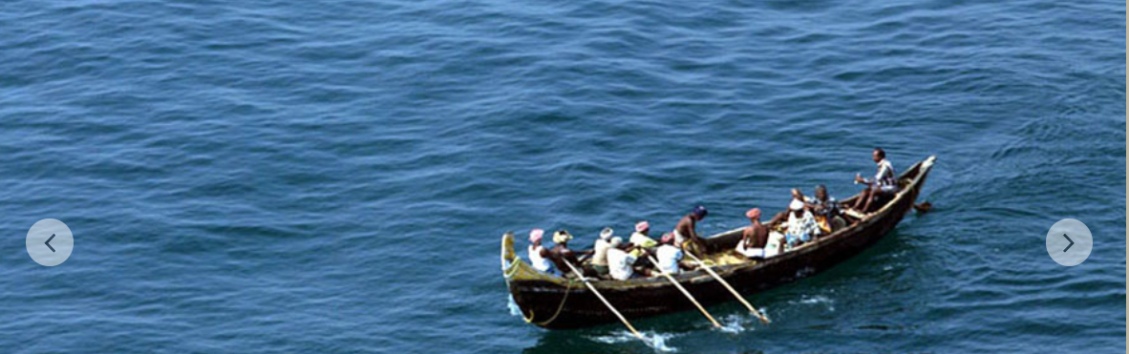
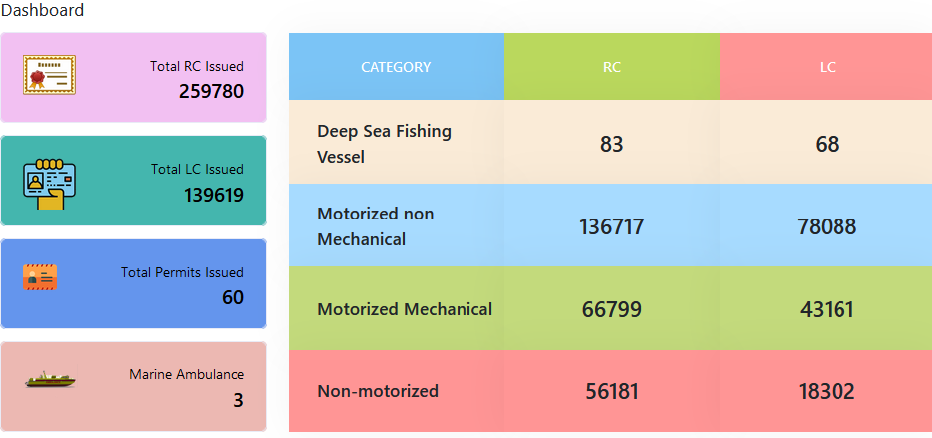
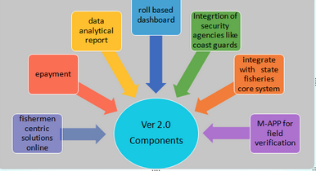
REGISTRATION AND LICENSING OF FISHING CRAFT
ReALCRaft is a web enabled workflow based online application system for issuing Registration Certificate (RC) Under MS Act (Merchant Shipping) and Fishing License Certificate (LC) to fishing vessels operating along the Indian Coast under MFR (Marine Fisheries Regulation )Act.
It is a demand driven project to enhance coastal security by identifying every fishing vessel with a unique registration number.
The database is also shared with various stakeholders including National Security Agencies and State Governments to facilitate various support services including management of beneficiary schemes. The Components are

Slide 4
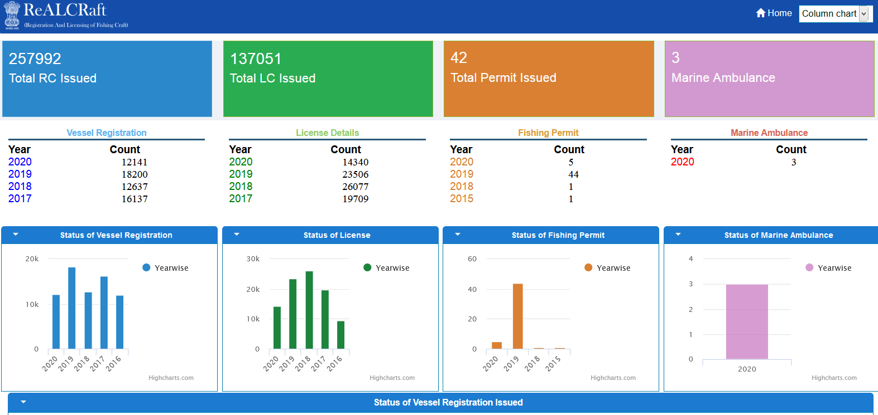

Slide 5
REGISTRATION AND LICENSING OF FISHING CRAFT
ReALCRAft
Background
The ReALCraft project was originally developed for the Kerala State under Kerala Marine Fisheries Regulation Act (KMFRA) on 2009 .
During the National Workshop on 21st Jan 2009 development of ‘Fisheries Information System Network (FISHNET)’, GoI recommended that the ReALCraft System to be rolled out in all Coastal States and UTs.
After the Mumbai attack 2009, Government of India decided to gear up coastal security and have a uniform mechanism to identify each and every fishing vessel operating in Indian coastal belt.
Govt. of Kerala initiated this project way back in 2008, when repeated cases of missing boats were reported and the Officials found it difficult to identify the boats due to lack of uniformity, multiple registrations for the same boat and same engine registered for multiple Vessels etc . This paved the way to introduce ICT based uniform system for vessel registration and Licensing for fishing Operations.
When Indian coastal security was thus threatened, GoI decided to implement the Kerala model ‘ReALCraft’, in all the 9 Coastal States & 4 UT’s on 01/01/2011

Slide 6
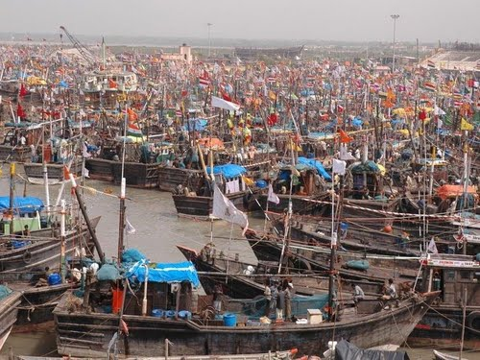
REGISTRATION AND LICENSING OF FISHING CRAFT
Objectives
To bring all the Indian fishing vessels (about 2.5 lakh ) under one hub
To prepare National database for fishing vessels.
To regulate the movements of fishing vessels
To strengthen coastal security and security of fishermen in the sea.
To Prevent IUU - Illegal, unregistered and unreported vessels in the territorial waters
To facilitate optimum utilization of the fishery resources
Assists the coastal security agencies – is as a part of comprehensive coastal monitoring, control and surveillance system)
Back bone for other services to the fishermen like insurance claim, subsidy claim, fuel permit, monitoring the movements of crews etc

Slide 7
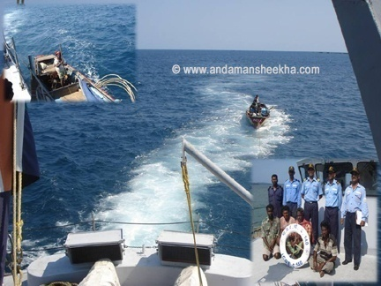
REGISTRATION AND LICENSING OF FISHING CRAFT
Benefits
Helps coastal security agencies in pin point and monitoring the fishing vessels, keeping at bay illegal, unregistered and unreported activities. The project also aims at security for our fishermen.
Improves coastal security, fishermen security, and ensures benefits such as kerosene and petrol subsidy along with insurance to fishermen
Rescue measures can be initiated timely with the help of the Data available in the System during disaster

Slide 8
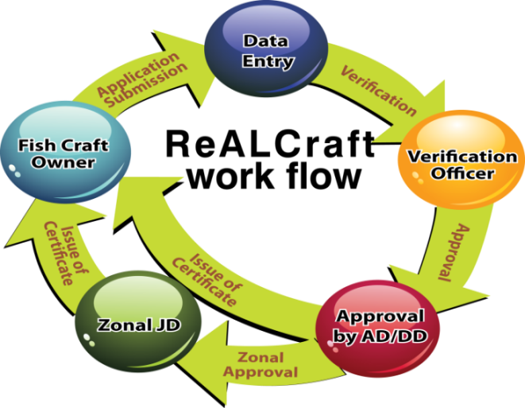
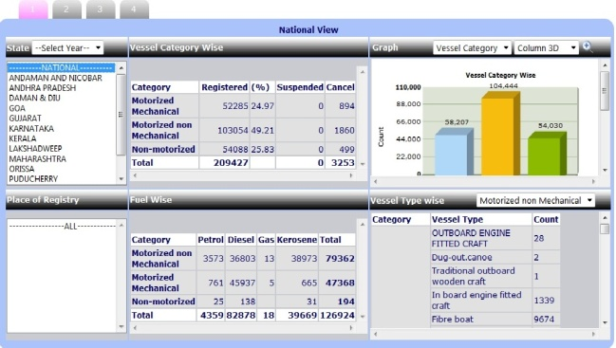
REGISTRATION AND LICENSING OF FISHING CRAFT
Features
Centralised hosting at National Data Centre and DR Site in Bhubaneswar.
Integration with state-specific payment gateway (Bank /treasury),
Integration with security agencies to record the movements and track the vessels.
Upstream integration with insurance agencies, subsidy schemems for edbt and Aadhaar (for authentica-tion) .
Integration & data sharing with Govt. Agencies/ security Agencies ,DigiLocker ,CM dashboard .
Comprehensive dashboard, data analytics.
Fisheremen centric soultions.
Advanced Search
Roll based dashboard
Bilingual
Vessel name
ENGINE NUMBER
RC/LC

Slide 9
REGISTRATION AND LICENSING OF FISHING CRAFT
Stakeholders
Target users
GOI
DGLL
Coast Guard
NPOL
State Govt
Offshore Defence Advisory Group:
JOC
MOC
Vessel owners
NC3I

Slide 10
REGISTRATION AND LICENSING OF FISHING CRAFT
Services
1. Registry of transfer of ownership or interest
1. Registration
2. License
3. RC related other Services
4. Reports MIS
5. Reports BI
6. Search
7. Help
8. Issue of certificate
9. Impounding
10. Issuing duplicate certificates
3. Special permit
2. Transfer of ownership by operation of law
3. Fishing boats owned by minors
4. Transfer of registry
5. Change of name of fishing boat
6.Registry of alterations materially affects the dim
7. Registry of alterations materially not affect the dim
8. Provisional certificate of registry
9. Inspection of register & supply of certified copies
10. Closing of registry
11. Change in crew details
12. Change in Vessel insurance
13. Change in subsidy details
14. RC duplicate
15. Mortgage

Slide 11
REGISTRATION AND LICENSING OF FISHING CRAFT
Additional Enhancements
Security Agencies (2019)
Integrated with Security Agencies like Coast Guard, Marine Police and State Fisheries Departments for monitoring the vessels using open API. This enables these agencies and departments to monitor the movement of vessels as well as identity verification.
IMAC (2020)
Integrated with Information Management And analysis Centre (IMAC) as part of National Command Control Communication and Intelligence (NC3) network to ensure the security and safety of fishermen as well as managing national security.
SAGARA(2018 )
Integrated SAGARA mobile app and web portal with ReALCRAft data base for the management of Fishermen Onboarding, their movements from various fishing locations and for the monitoring of Vessel and Crew Movement and useful Monitoring during emergencies and Disastrous Management.
MPEDA(2016,2017)
Integrated with MPEDA using open API for verification of vessel for issuing catch certificate for export purpose.
State Fisheries departments using the realcraft data for diesel subsidy using open API.
Other Services(2018)
Back bone for other services to the fishermen like insurance claim, subsidy claim, fuel permit, monitoring the movements of crews etc
Special Permit & MARINE Ambulance (2020)
Introduced Special permit for vessels having hull length > 20 meters and 250 HP
Additional category of Deep Sea Fishing vessels added
Configured Registration module for issuing RC to the Marine Ambulances for rescue Operations.
Configured for issuing RC & LC for Marine Ambulance in Kerala

Slide 12
2010
2011
2012
2013
2014
2015
2016
2017
2018
2019
2020
REGISTRATION AND LICENSING OF FISHING CRAFT
Additional Enhancements
Deep sea vessels
Integrate with NC3I
Seamless integration with
SAGARA, FIMS, SELF
Rollout sagara in Kerala,
Service to marine Police
Force , Coast guard
Integrate with DARPAN
e-gov dashboard,SAGARA,
Fishermen registration
Integrate with DGLL pilot
project AIS , Gujarat
Integrate with MPEDA, ,
Karnataka – diesel
subsidy scheme
Integrate with DGLL
Integrate with ICSS –
DRDO
Complete Rollout in all
states & UTS
Pilot Rollout in all states & UTS
Rollout Kerala
Special permit, marine ambulanec
Integrate with e-Fuel Bunk
Service toCoastal Security Agencies like Coast Guards, NAVY, Marine police force , NPOL, DGLL
Fuel permit issuance system to MUMBAI
Fuel permit issuance system to KERALA

Slide 13
Monitoring Mechanism
MHA, State Fisheries Dept generating
National–wide, State-wide , Place of registry, base of operation, vessel wise reports.
Central Admin,
Respective state admin,
Feedback

Slide 14
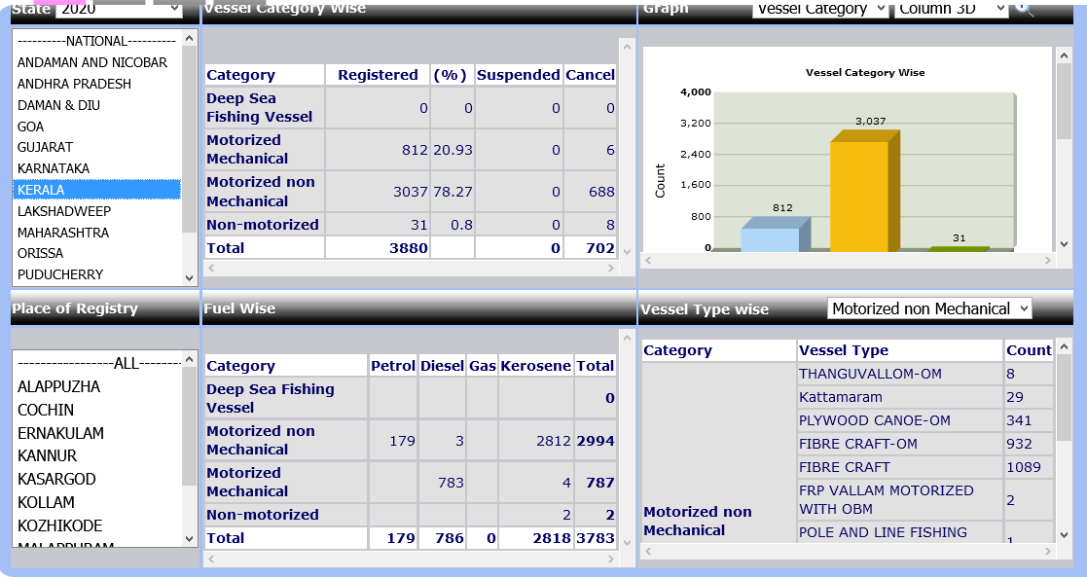
REGISTRATION AND LICENSING OF FISHING CRAFT
Monitoring Mechanism

Slide 15
REGISTRATION AND LICENSING OF FISHING CRAFT
Technology Enhancements
Technology upgraddation
The PHP version has been changed from 5.3 to 7.4. Framework upgraded PostgreSql upgraded to latest version (12) Moved from Server fabric at NDC Hyderabad to Mini Cloud Data Centre at NIC Kerala. Security Audit Done for the latest platform and Source Code Analysis also completed with Periodic Pen Tests RestFul Web Services / API introduced for third party and state and central e-Gov application integration.

Slide 16
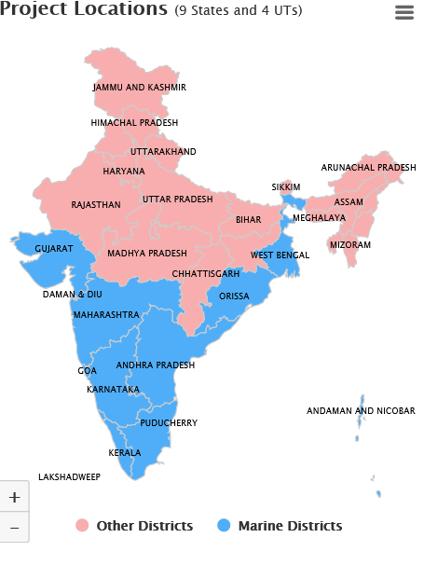
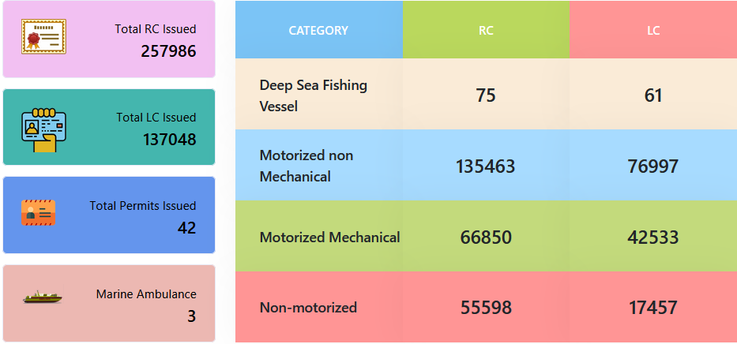
REGISTRATION AND LICENSING OF FISHING CRAFT
Present status - Implementation
Operational from 166 locations along the coastal line, Around 2.90 laks vessels have been registered
Around 1000 users are accessing the system
Stakeholders - Navy, Coast Guards, Marine Police, Fisheries Authorities, Ministry of Home Affairs, DRDO Labs associated with Coastal Security.. Legal issues - Marine Shipping Act 1988 modified , Security agencies like Coast Guards , DGLL uses Vessel Registration No. (Unique) in their National Automatic Identification System (NAIS) for Fishing Vessels

Slide 17
REGISTRATION AND LICENSING OF FISHING CRAFT
Implementation ..
Name of State | Deep Sea Fishing Vessel | Motorized non Mechanical | Motorized Mechanical | Non-motorized | Total
ANDAMAN AND NICOBAR | 0 | 2200 | 141 | 1471 | 3812
ANDHRA PRADESH | 0 | 26406 | 2461 | 18723 | 47590
DAMAN & DIU | 2 | 320 | 2145 | 0 | 2467
GOA | 0 | 0 | 2922 | 304 | 3226
GUJARAT | 59 | 11917 | 17358 | 78 | 29412
KARNATAKA | 0 | 9857 | 4748 | 7457 | 22062
KERALA | 10 | 34523 | 6154 | 2918 | 43605
LAKSHADWEEP | 0 | 1586 | 52 | 413 | 2051
MAHARASHTRA | 0 | 0 | 22189 | 8371 | 30560
ORISSA | 0 | 15895 | 1919 | 17529 | 35343
PUDUCHERRY | 0 | 2246 | 773 | 821 | 3840
TAMIL NADU | 0 | 42753 | 7256 | 7238 | 57247
WEST BENGAL | 0 | 6242 | 3640 | 6823 | 16705
TOTAL | 71 | 153945 | 71758 | 72146 | 297920
Vessels Registered
as on 01/10/2020
(Including Live, Cancelled, Suspended)

Slide 18
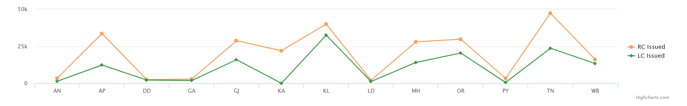
REGISTRATION AND LICENSING OF FISHING CRAFT
Implementation ..
Name of State | Deep Sea Fishing Vessel | Motorized non Mechanical | Motorized Mechanical | Non-motorized | Total
ANDAMAN AND NICOBAR | 0 | 2200 | 141 | 1471 | 3812
ANDHRA PRADESH | 0 | 26406 | 2461 | 18723 | 47590
DAMAN & DIU | 2 | 320 | 2145 | 0 | 2467
GOA | 0 | 0 | 2922 | 304 | 3226
GUJARAT | 59 | 11917 | 17358 | 78 | 29412
KARNATAKA | 0 | 9857 | 4748 | 7457 | 22062
KERALA | 10 | 34523 | 6154 | 2918 | 43605
LAKSHADWEEP | 0 | 1586 | 52 | 413 | 2051
MAHARASHTRA | 0 | 0 | 22189 | 8371 | 30560
ORISSA | 0 | 15895 | 1919 | 17529 | 35343
PUDUCHERRY | 0 | 2246 | 773 | 821 | 3840
TAMIL NADU | 0 | 42753 | 7256 | 7238 | 57247
WEST BENGAL | 0 | 6242 | 3640 | 6823 | 16705
TOTAL | 71 | 153945 | 71758 | 72146 | 297920

Slide 19
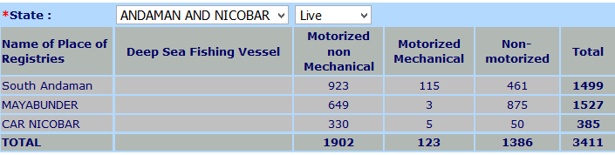
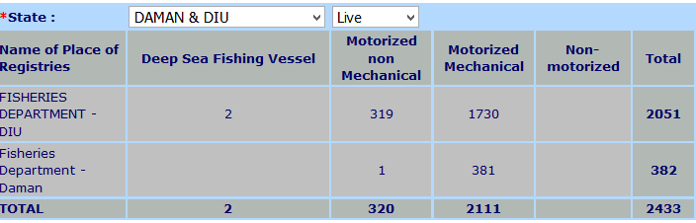
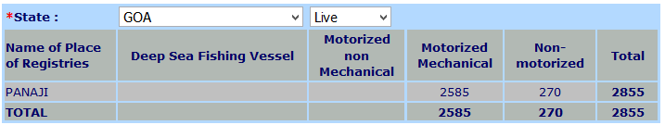
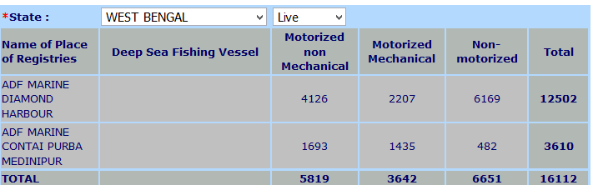
REGISTRATION AND LICENSING OF FISHING CRAFT
Implementation ..

Slide 20
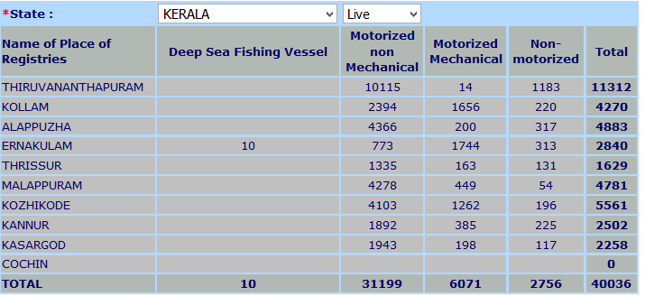
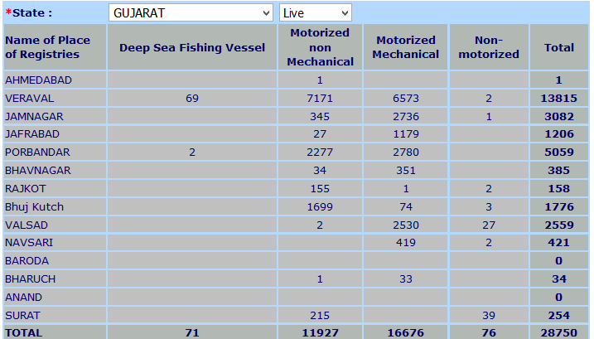
REGISTRATION AND LICENSING OF FISHING CRAFT
Implementation ..

Slide 21
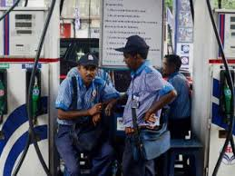
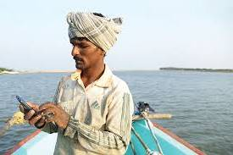


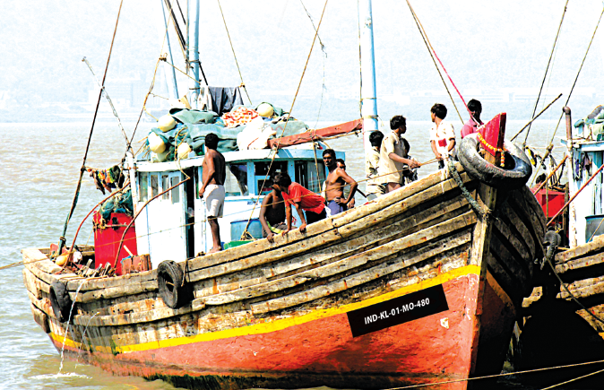

REGISTRATION AND LICENSING OF FISHING CRAFT
Impact & Outcome
Integrated with SELF (Fuel Permit Management System) to streamline the fuel Card distribution to the registered vessel owners and fuel distribution to the valid fuel permit holders with the aim of providing total integrated end to end solution to the Fishermen and to Increase the efficiency of the subsidy disbursal to the right fishermen in right time , Reduce pilferage , Eliminate middle layer in fuel procurement
Coastal State &UTs
Integration with e-Gov applications – as a Back bone for other services to the fishermen like insurance claim, subsidy claim, fuel permit, monitoring the movements of crews etc
SAGARA
Mobile App and Portal – MHA has identified SAGARA as the national software for onboarding fishermen.
Integrated with Security Agencies like Coast Guard, Marine Police and State Fisheries Departments , IMAC (NC3I) for monitoring the vessels using open API. This enables these agencies and departments to monitor the movement of vessels as well as identity verification.

Slide 22

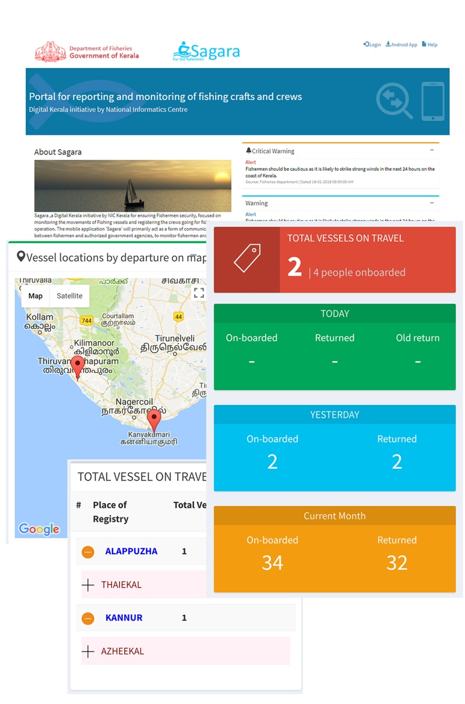
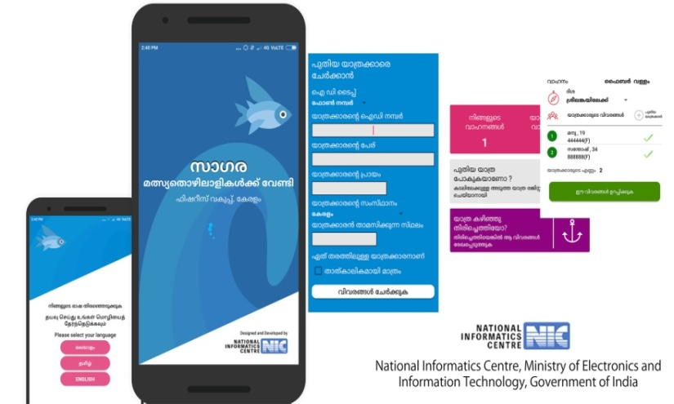
REGISTRATION AND LICENSING OF FISHING CRAFT
Enhancements Provided
Developed Mobile App for fishermen and Web Portal for Dept to monitor the crew movements.
https://sagara.kerala.gov.in
A Joint Initiative of
Department of Fisheries, Govt. of Kerala and National Informatics Centre, Kerala.
This is for ensuring fishermen Safety & Security. Focus is given on monitoring the movements of fishing vessels going for fishing operation and the companying crews. This will primarily act as a form of communication between fishermen and authorized government agencies.

Slide 23
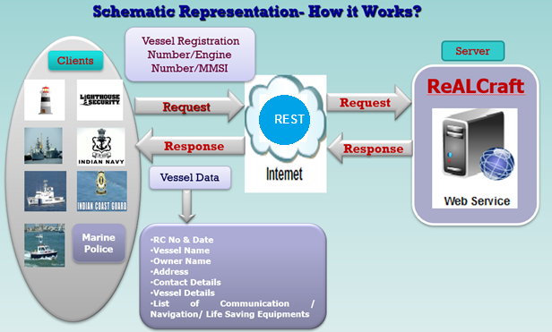
REGISTRATION AND LICENSING OF FISHING CRAFT
Why integrating with ReALCRAft
How it can be done
The Navy and Coast Guard, with the help of State Government Fisheries Depts, are going to install transponders in all private boats of Indian fishermen to locate their position in the sea. These transponders will be connected through the NC3I for monitoring the vessels in the Indian Territorial water. .
Multilingual Selection
NC3I integration needs real time vessel details of ReALCRAft.
Using the Secured API, vessel database can be integrated with NC3I.
In ReALCRAFt , provision is already available to capture any transponders fitted with vessels.

Slide 24
REGISTRATION AND LICENSING OF FISHING CRAFT
BPR
Uniform integrated platform for filing application at a single point.
Introduced uniform RC & LC
To enable an easy commencement and operation of application, MS Act and respective Marine fisheries Regulation act Amended
Integrated with e-GOV applications using OPEN API

Slide 25
REGISTRATION AND LICENSING OF FISHING CRAFT
Each of the States & Ut’s had their respective Marine regulation acts with their own format and procedures for registration of fishing vessels which differed from each other
Pre deployment
No specific fee criteria
No mechanism to track the vessels
procedural issues in movement of vessels from one state to other

Slide 26
REGISTRATION AND LICENSING OF FISHING CRAFT
Uniform format of registration and DG, Shipping issued a notification under Merchant Shipping (MS) Act, notifying a format based, on ReALCraft Application, for registration of Fishing Vessels. It was decided that all fishing vessels less than 20 metres in length will be registered under MS Act.
Each of the States & Ut’s had their respective Marine regulation acts with their own format and procedures for registration of fishing vessels which differed from each other
Pre deployment
Post deployment
The implementation of this system will bring all the 3, 00,000-odd fishing vessels into one National Database. Availability of a comprehensive database on fishing vessels, will help in identifying fishing vessels involved in fishing operations in Indian waters and also give the information on the movement of these vessels. SMS.
No specific fee criteria
No mechanism to track the vessels
procedural issues in movement of vessels from one state to other
The process of issuing Fishing License and Registration Certificate of Fishing Crafts to Fishermen will become much faster, transparent and hassle free. Not only this, fishermen will be able to get status of their application by simply sending their registration number through SMS.

Slide 27
REGISTRATION AND LICENSING OF FISHING CRAFT
Each of the States & Ut’s had their respective Marine regulation acts with their own format and procedures for registration of fishing vessels which differed from each other
To facilitates the Coastal Security Agencies in uniquely identifying and monitoring the fishermen and fishing vessels in the sea to prevent illegal unregulated and unreported fishing.
Pre deployment
Post deployment
A database on Fishing Vessels and their movement facilitates Fisheries Informatics for Decision Support and Information Access. Thus, this application would help to check and track suspicious vessels in Indian waters, by providing instant information of a specified vessel. It would also prevent illegal, unregistered and unreported vessels in the territorial waters, strengthening security of the coasts as well as the security of Indian fishermen at sea.
No specific fee criteria
No mechanism to track the vessels
procedural issues in movement of vessels from one state to other

Slide 28
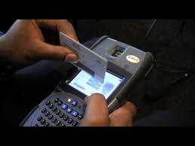
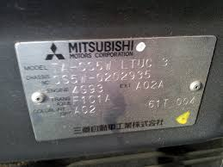
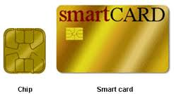
REGISTRATION AND LICENSING OF FISHING CRAFT
Way forward
Interoperability framework & SSO in progress
Boat Building Yard registration, provide Chassis No. for Vessels
Issuing smart card to fishing vessels, fishermen
Integrate SAGARA , rollout across the country in progress
Onboard Catch details in SAGARA mobile application
Networking of Marine Fish Landing Centers (~ 200) – similar to application AGMARKNET

Slide 29
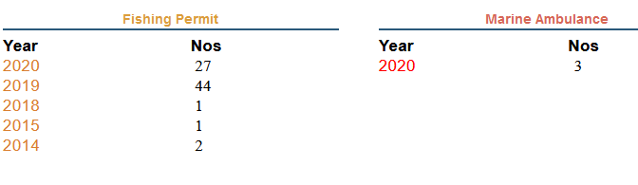
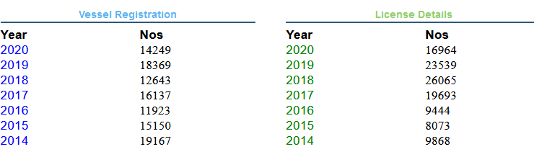
REGISTRATION AND LICENSING OF FISHING CRAFT
ReALCRAft
Comparison
YEAR | NO.OF SERVICES | VOLUME OF TRANSACTIONS | USERS | RC | LC
2014-15 | 19 | 114026 | 1000 | 35317 | 17941
2019-20 | 32 | 252052 | 9995 | 32618 | 40503

Slide 31
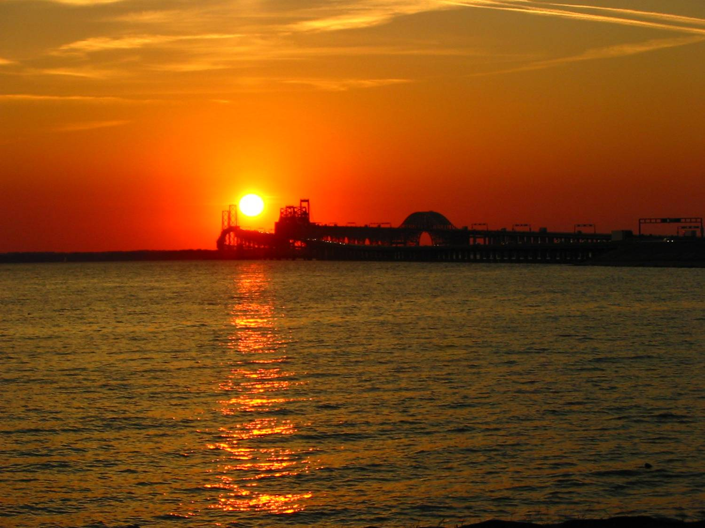
REGISTRATION AND LICENSING OF FISHING CRAFT
Thank You…

